Slide 1
SOP Writing and Document Control for the Research Laboratory
Zahra Shajani Yi, PhD NRCC
Assistant Professor of Pathology, Microbiology and Immunology
Vanderbilt University School of Medicine
Associate Directory of Clinical Chemistry
Medical Director of Esoteric Chemistry
Vanderbilt University Medical Center

Slide 2
Objectives
Understand the difference between Research and Development and Operations and that they require different tools
Understand what is a Standard Operating Procedure (SOP) and how it impacts operations
Most importantly, determine if an SOP will be useful to your Core Facility

Slide 3
Outline
Different goals require different tools
Differences between Research and Clinical Laboratories
Differences between Research and Development and Clinical Operations
Standard Operating Procedures (SOP)
When and why one should use a SOP
Components of a SOP
Maintaining a SOP

Slide 4
My Background
Scientist
Trained as a chemist and biophysical chemist
Transitioned into molecular biology
Currently faculty at VU and an associate medical director of clinical laboratories at VUMC
Research for about 15 years
Undergraduate (2 years)
PhD (6 years)
Post-doctoral Fellow (4 years)
Clinical Fellow (2 years)
Medical Director (>1 year)

Slide 5
My Background
Not an operations person
Believed that it stifled creativity
Lab reports were once written like philosophy essays
My procedures were minimal in detail at times. I relied on my memory a lot day to day.
Now I understand that research and development and clinical operations need some different tools

Slide 6
Some Difference
Research Laboratory
Clinical/Core Laboratory
Hypothesis-driven research
More flexible with time
Creativity is important
Variation and Optimization is welcome
End-User: PI and yourself
Patients/clinical trials
Time constraints
Need consistency
Reproducible
Regulatory component
End User—patient or clinician
Different styles of learning

Slide 7
My Background
Wide range of techniques
Crystal Growth
RNA preparation and purification
Ribosome Preparation
Agarose Gel
Acrylamide Gels
NMR
Mass Spectrometry
How do you learn new skills/techniques?

Slide 8
How do we learn new skills/techniques?
Observation
Asking questions
Taking notes
Reading
Notes:
Thinking back—how did I learn?

Slide 9
How do we learn new skills/techniques?
Observation
Asking questions
Taking notes
Reading
Develop a general Procedure
Notes:
Thinking back—how did I learn?

Slide 10
That discovery is part of the process
“Could have completed by 5 ½ years of PhD work in < 6 months time-wise if I had known at the beginning what I knew at the end”
But discovery is part of the training
Notes:
Explain Discovery—how to put al that i

Slide 11
How do we teach others?
Research trainees
Supply articles
Ask questions to demonstrate understanding
Have them observe and make their own procedure
Current trainees (residents and fellows):
Supply articles
Quizzes to demonstrate understanding
Projects and case studies

Slide 12
How do we teach others?
Why did I not just give them my makeshift procedure?
Giving a procedure tells them how to do things, but not why
I feel that making those cognitive connections on how to synthesize information is as important if not more then the research findings

Slide 13
Transitioning to the Clinical World: Accuracy and Reproducibility
As scientists we strive for the best and “good enough” is usually not acceptable
That does not change in a core laboratory, but the role of a core is different then of a research laboratory
Now performing a service
Other researchers/clinical trials will depend on the result
Results need to be Accurate and Reproducible

Slide 14
How to minimize variation?
Crystal Growth
Mass spectrometry
Grad students would often play around with buffer conditions and elution programs
All had slightly different results
If we did that for drug confirmations, what would happen?
Molecular Genetics
Variant calling
Running gels
Different buffer or voltage changes mobility

Slide 15
Consistent Processes allow for effective troubleshooting
Troubleshooting: We’ve all had to do it!
Reagent?
Instrument?
Operator?
Consistency allows for troubleshooting and traceability
Examples
Mishandling material
Notes:
Give examples

Slide 16
Accuracy, Consistency and Reproducibility in a Core Facility
On a small scale accuracy, consistency and reproducibility are easier
Less operators
Developer often knows the intricacies of the system
Recall: a large proportion of scientific studies cannot be reproduced by other operators
Why?
Notes:
Discuss the why

Slide 17
Scaling Up
Even the best idea can fail if it cannot be successfully operationalized and scaled
Engineering (Chip manufacturers, wi-fi)
Manufacturing (Tesla Model 3)
Consumer Electronics (iPhone)
Clinical Assays (Biomarkers and Automation)
Why do start-ups with great ideas fail?
Notes:
Most sensitive biomarkers are of no use in the clinical lab if they cannot be operationalized and scale.

Slide 18
Transitioning to Clinical World: Scalability
To grow the laboratory, process must be scalable
How to ensure consistency and reliability when there are multiple operators?

Slide 19
Standard Operating Procedures (SOP)

Slide 20
What is an SOP?
Standard Operating Procedure (SOP): is a set of step-by-step instructions compiled by an organization to help workers carry out complex routine operations. SOPs aim to achieve efficiency, quality output and uniformity of performance, while reducing miscommunication…
https://en.wikipedia.org/wiki/Standard_operating_procedure

Slide 21
SOP
An SOP helps ensure that results are reproducible between operators and over time, allows for operations to be scaled up and that the procedure is executed in a consistent way.

Slide 22
Why create an SOP?
Reproducibility and Consistency
Reduce Variability
Never want to be dependent on one person
Improves Communication
Scale
Think of all the research you have done
Imagine scaling it up 2x. 10x. 100x

Slide 23
Components of a SOP
Purpose or Principle
Scope
Specimen
Supplies and Reagents
Safety
Equipment, Maintenance and Calibration
Quality Control
Stepwise Procedure
Expected Values, Result Reporting and Interpretation
Procedure Notes
Procedure Limitations
References
Nothing is too obvious to be included!

Slide 24
Components of a SOP (v2)
Purpose or Principle
Scope
Definitions
Specimen Requirements
Equipment, Reagents and Required Forms
Equipment Calibration/Process Validation
Quality Control
Procedure and Calculations
Interpretations of Results, Reference Values and Acceptable Criteria
Reporting of Results
Limitations, Troubleshoot or Comments
References

Slide 25
1. Purpose or Principle
Describe what the test is used for
Can be brief or very descriptive
We often describe what the analyte is used for
2. Scope
Where is the SOP used
Who is to use it
Sometime include test principle

Slide 26
3. Specimen
Human, animals or synthetic
Blood, Urine, Body Fluid
Sample volume
4. Supplies and Regents
Self-explanatory
Keep in mind that if you are very detailed, you will have to update if there are any changes

Slide 27
5. Safety
Protective gear required?
Special Handling?
6. Equipment, Maintenance and Calibration
Should be as detailed as possible to ensure consistency
Ex: How often should instrument be calibrated?
How should material be handled?

Slide 28
7. Quality Control (QC)
Can be combined into 6
Should describe how often QC is used and how it is handled
8. Stepwise Procedure
Should be as detailed as possible to ensure consistency

Slide 29
9. Expected Values, Results Reporting and Interpretations
Important for ensuring that results are reported correctly
Reference Range
Lists any flags or exceptions
10. Procedure Notes
Can describe how to troubleshooting
Any misc issues.
Validation information?

Slide 30
11. Procedure Limitations
Sensitivity, Specificity and Interferences
12. References
Important to verify that information in procedure is correct

Slide 31
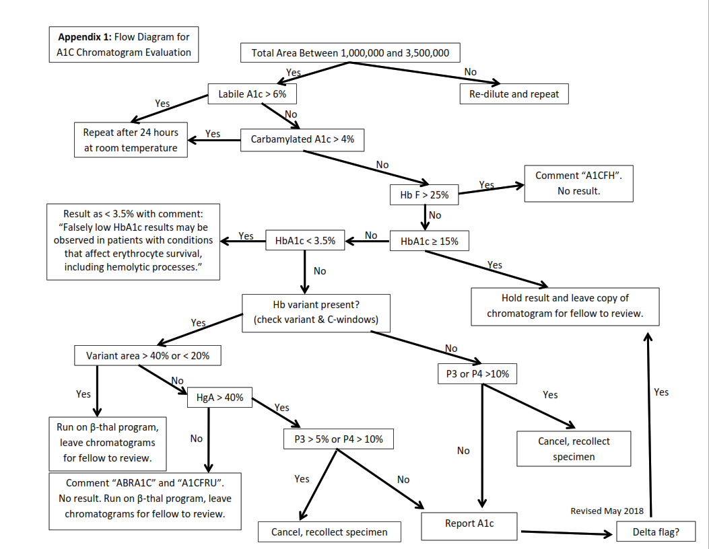
Tables and Charts are helpful

Slide 32
Scenario: Clinical Laboratory Section
Within 9 months, new supervisor, 50% new staff and new medical director
Historically section relied heavily on one person, and word of mouth training.
SOP was out of date and no one used it
Post-it notes everywhere
Hand-written changes, undated
Lack of consistency
“We have always done it this way?”
Notes:
Out of date SOP’s. A lot of things “we’ve always done it this way”

Slide 33
Scenario: Updating an out of date SOP
How would you start?

Slide 34
Scenario: Updating an out of date SOP
How would you start?
Assign a lead to each area
Have the person who knows the procedure the best work on it
Person in charge of updating policy and training
After updating policy have a second technologist/operator read through and make comments
Only follow procedure

Slide 35
Maintaining an SOP
Make updates as needed
Spot check as needed
Make sure every change is communicated
Meeting to verbally highlight the new changes
Employees have read new policy

Slide 36
Tables and Charts

Slide 37
Some Document Control Platforms
PolicyTech (VUMC)
Manual Method—upload PDF documents
MediaLab
OnBase
Master Control
Things to remember: must Date and Sign!

Slide 38
Summary
Research and Development and Operations require different tools
A SOP can help with communication and establishing consistency in processes
Many different methods to develop and maintain SOP

Slide 39
SOP and Processes
Caution against perfection: “Don’t let the perfect get in the way of the good”
Vitamin D
A “perfect test” is not perfect if it cannot be used

Slide 40
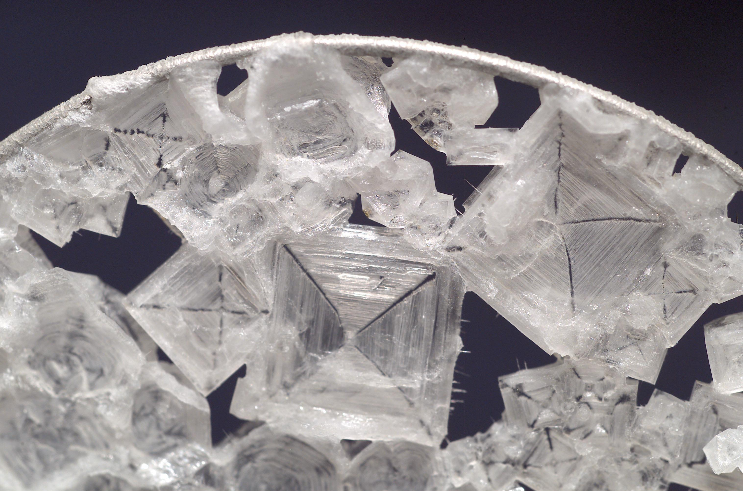
Remember when….
The first time you had to:
Grow crystals?
Pour a gel?
Solve a structure?
NMR, Mass spec, HPLC or [insert favorite technique]
What would you do differently now?

